Slide 1
Art of a New Nation: The United States

Slide 2
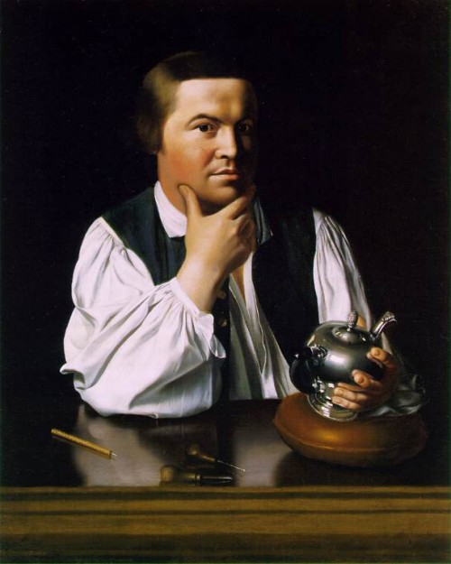
John Singleton Copley Paul Revere

Slide 3
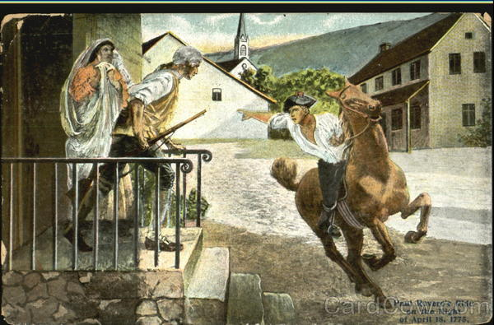
April 18, 1775

Slide 4
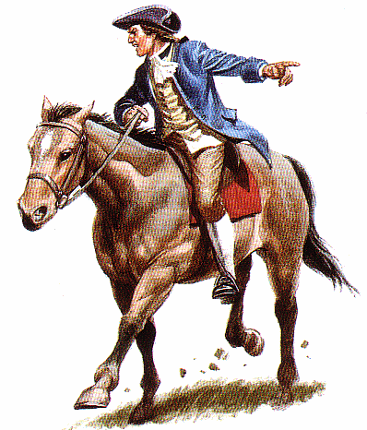
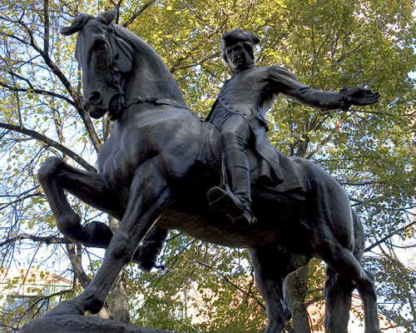

Slide 5
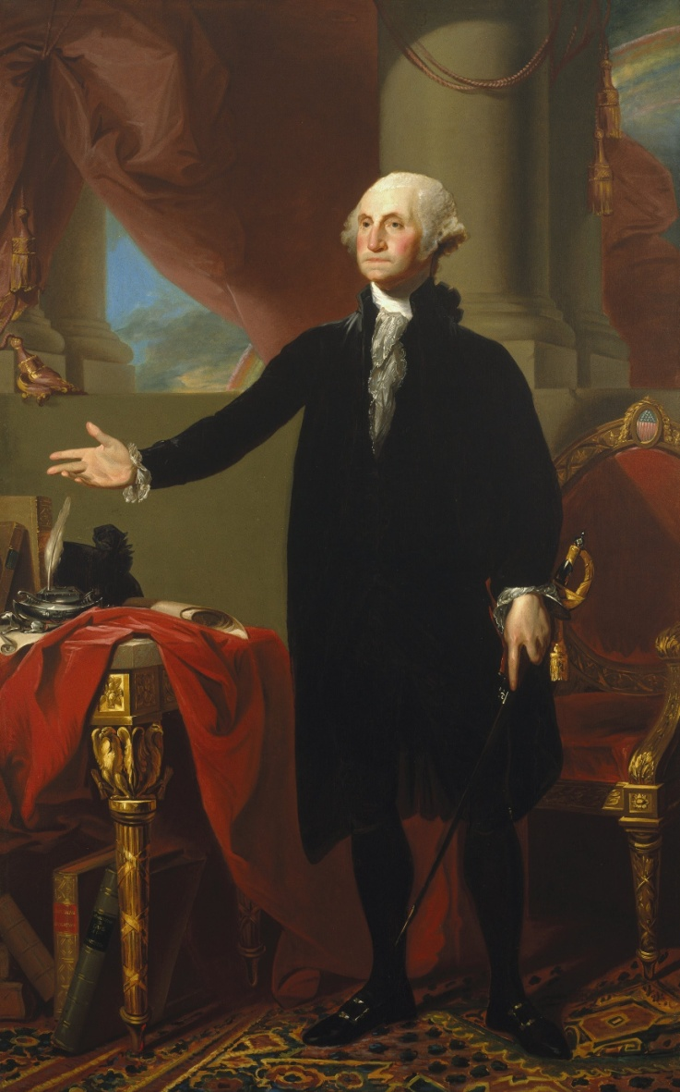
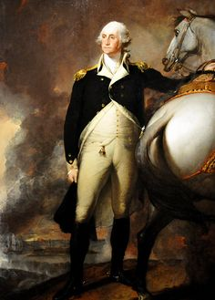
Gilbert Stuart,
George Washington

Slide 6
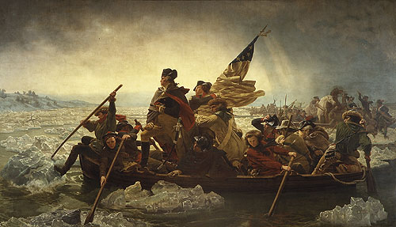
Emanuel Gottlieb Leutze, George Washington Crossing the Delaware

Slide 7
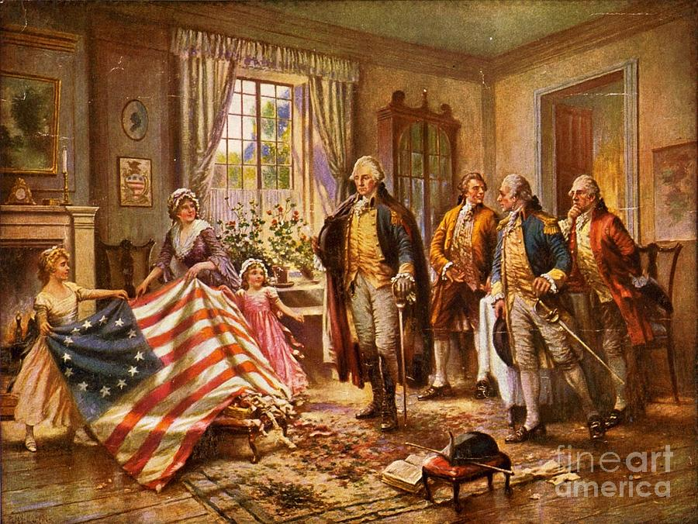
Jean Ferris, Betsy Ross Showing Flag to George Washington

Slide 8
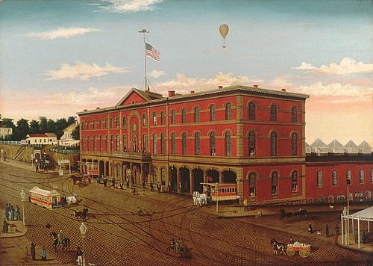
William Schenck, The Third Avenue Railroad Depot

Slide 9
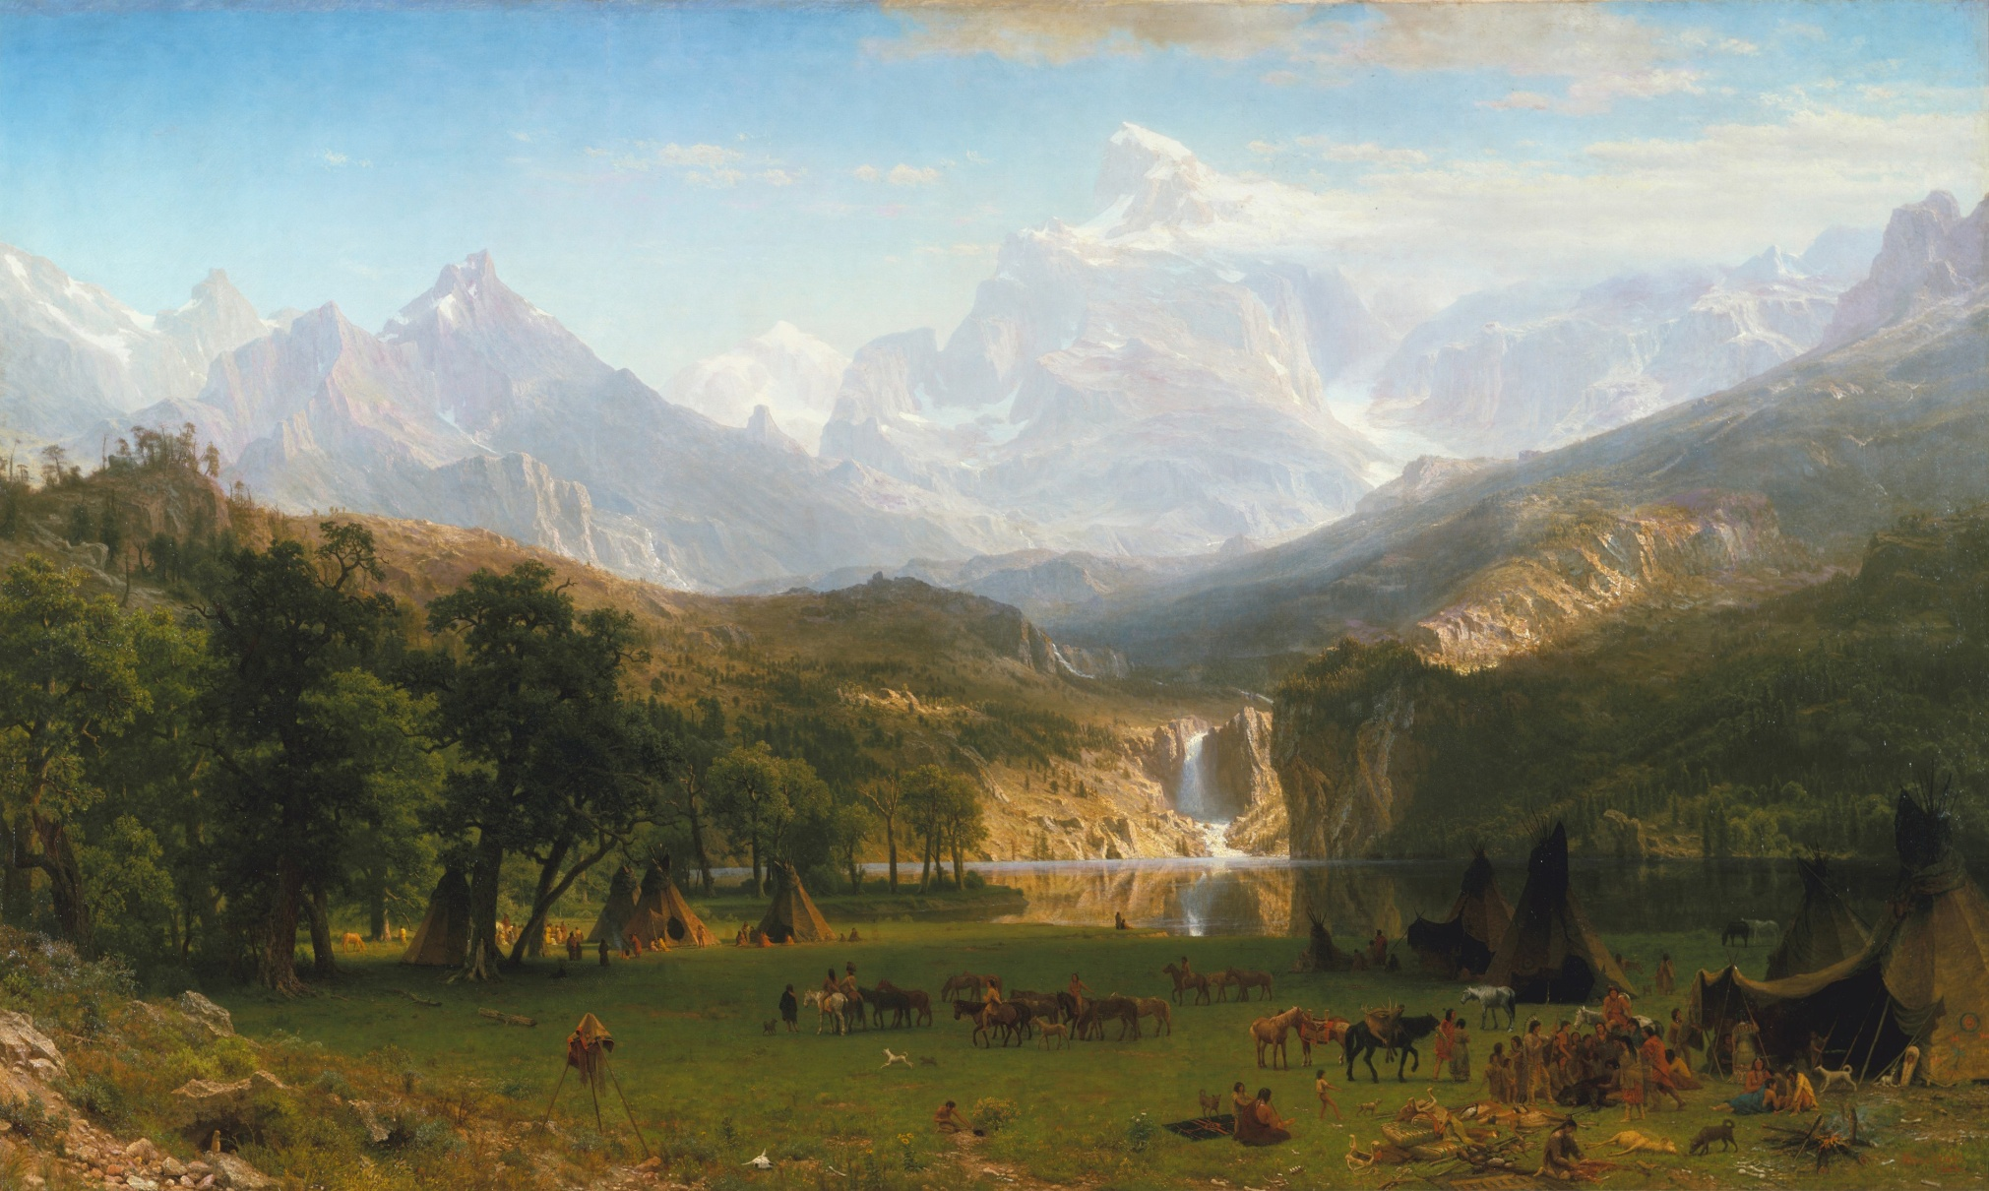
Albert Bierstadt, The Rocky Mountains, Lander’s Peak

Slide 10
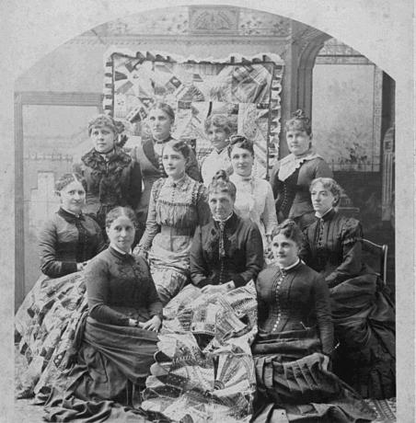
Quilting Bee

Slide 11
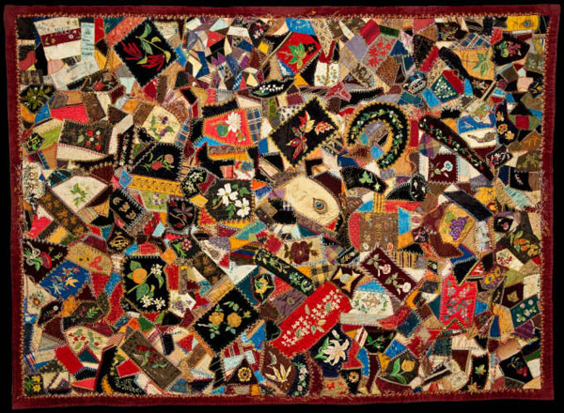
Antique Crazy Quilt

Slide 12
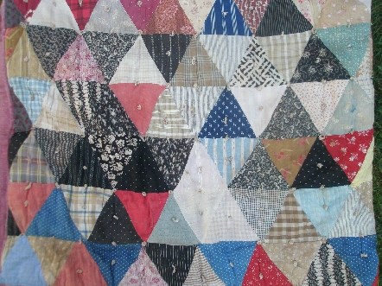
Antique Quilt, Triangles

